Slide 1
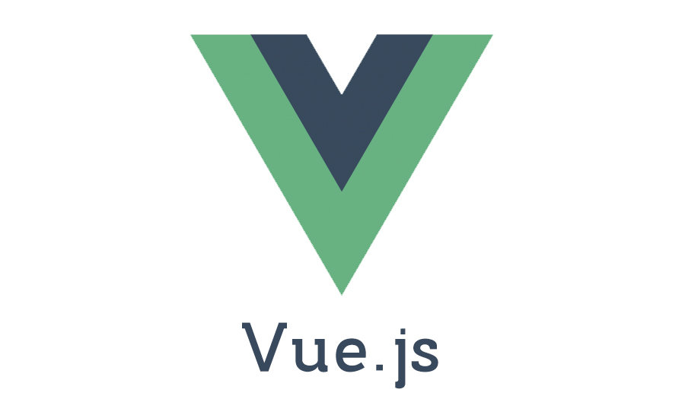
Getting started with Vue.js
-Taraka RaviTeja Peddi
-Akshara Gurram
-Manikanta Goud Bandari
- Sai Manikanta Durga Prasad Vinukonda
-Indra Reddy Mamidi

Slide 2





Taraka Raviteja
Indra Reddy
Manikanta Goud
Durga Prasad
Akshara Gurram

Slide 3
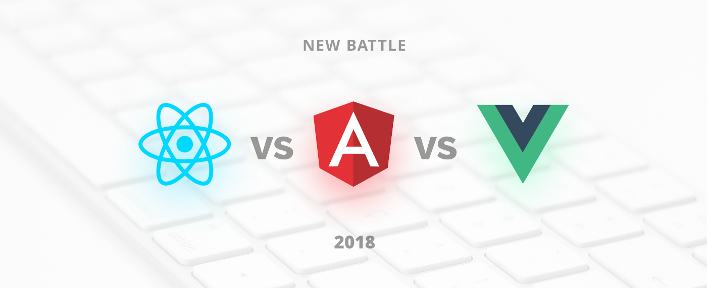
ReactJS vs Angular5 vs Vue.js

Slide 4
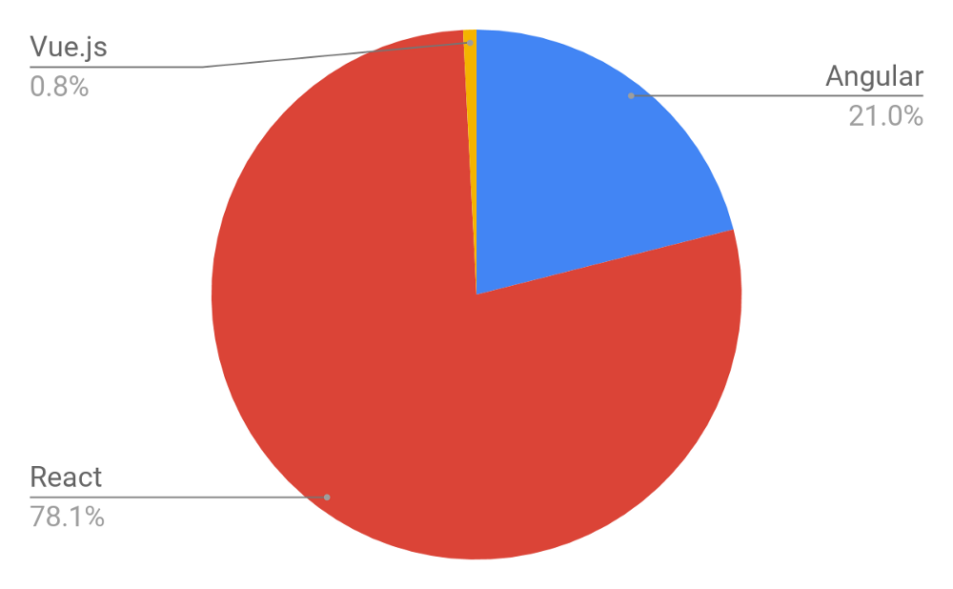
ReactJS vs Angular5 vs Vue.js
The number of open positions worldwide that require a specific knowledge of a certain framework. As a source, we took Indeed.com and got the following distribution according to more than 60,000 job offers.

Slide 5
ReactJS vs Angular5 vs Vue.js
Angular 5:
Angular is superheroic JavaScript MVVM framework, founded in 2009, which is awesome for building highly interactive web applications.
Upwork, Freelancer, Udemy, YouTube, Paypal, Nike, Google, Telegram, Weather, iStockphoto, AWS, Crunchbase.
ReactJS:
ReactJS is a JavaScript library, open sourced by Facebook in 2013, which is great for building huge web applications where data is changeable on a regular basis.
Facebook, Instagram, Netflix, New York Times, Yahoo, Khan Academy, Whatsapp, Codecademy, Dropbox, Airbnb, Asana, Atlassian, Intercom, Microsoft.
Notes:
Superheroic :
AngularJS is a framework used to develop dynamic web applications. t streamlines the process of application development by presenting a higher level of abstraction to a developer.

Slide 6
Why vue.js?
Progressive Framework.
Approachable front-end Framework.
New JQuery.

Slide 7
Introduction
Created by Evan You.
Picks angular template syntax.
Picks virtual DOM from react.
Similar to mustache and handle bars.
How popular is vue.js?
More than 100,000+ stars in GitHub.

Slide 8
What is vue.js?
progressive JavaScript framework for building user interfaces.
Capable of creating complex single page applications.
Works in view layer only.

Slide 9
A RoadMap To Vue Developer
Basics Of Web Works
To know the Document Object Model
Javascripts Basics,Git
Webpack -
It is a tool that lets you compile JavaScript modules
And it is also known as module bundler.
It can rerun tasks.
It can run a development webserver.
Installation Of Webpack
By using npm
npm i-g webpack-cli

Slide 10
A RoadMap To Vue Developer
Event-Handling-
v-on is the attribute added to the DOM elements to listen to the events in VueJS
Routing-
Vue-router used to perform the Navigation between the pages
Components-
It creates a custom elements ,which can be reused in HTML
Templates-
It provides HTML-based templates that bind the DOM with the Vue instance data
Watchers
They are applied to data that changes.

Slide 11
A RoadMap To Vue Developer
Lightweight-
It is very lightweight and the performance is also very fast.
Vue-CLI-
Vue js can be installed by using the commandline-vue-cli
Directives-
To perform the frontend actions we use the directives such as v-if,v-else,v-bind,v-model
Flexibility-
VueJS can be easily merged with any other big projects without any issues.
Performing the End to End Tests using Cypress
Implementation of server-side rendering

Slide 12
A RoadMap To Vue Developer
VueJS uses html, JS and CSS separately
The template based approach for VueJS is very easy
Similarity Between Angular And VueJs
Directives such as a v-if, v-for is for VueJs
ngIf, ngFor is for AngularJs.
They both have a command Line interface but for vue -Vue-cli,
for angular-angular-cli

Slide 13
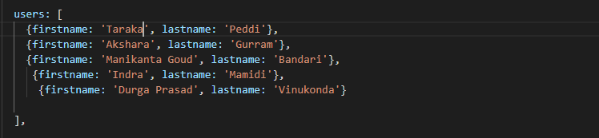
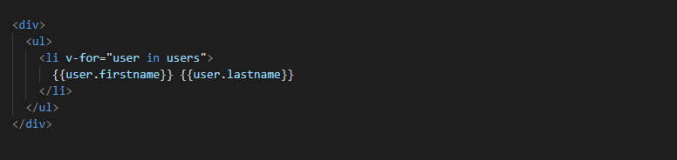
Directives:
V-for:
To include a list in the output printing out the firstname and lastname value of each array element:

Slide 14
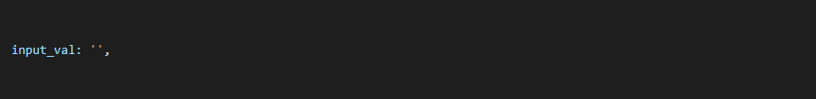
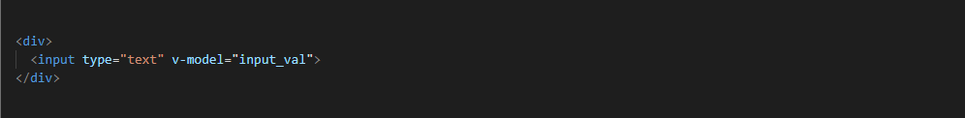
v-model:
The v-model directive creates a two-way binding on an input element or a component.
Then use the directive to bind the value of an input element to that property:

Slide 15
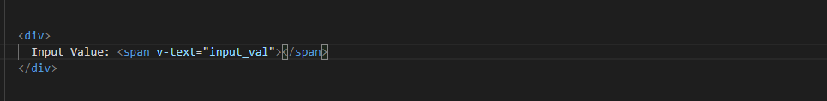
V-text:
V-text used to set the text content of the element.

Slide 16
Advantages of vue.js:
Empowered HTML.
Detailed documentation.
Adaptability.
Awesome integration.
Large scaling.
Tiny size.

Slide 17
Disadvantages of vue.js:
Lack of resources.
Risk of over flexibility.
Lack of full English documentation.

Slide 18
Conclusion:
For a real engineer, there is no substantial difference which framework to choose, because it just takes some time to get used to the new one.
Every framework has its own pros and cons, meaning that there should be just a right choice for every single case during the product development.

Slide 19
References:
https://vuejs.org/
https://medium.com/codingthesmartway-com-blog/vue-js-2-quickstart-tutorial-2017-246195cfbdd2
https://www.agriya.com/blog/pros-and-cons-of-vue-js-framework/
https://flaviocopes.com/vue-introduction/

Slide 20
Any queries…?

Slide 21
Thank you…!!!

